Slide 1
JULY 2023 | NEWSLETTER ISSUE 04
Critical
Critical information for immigrants regarding parenting to promote social inclusion
This project has been funded with support from the European Commission. This publication communication reflects the views only of the author, and the Commission cannot be held responsible for any use which may be made of the information contained therein.
AGREEMENT NUMBER
4th EDITION OF THE “CRITICAL” NEWSLETTER
2020-1-SE01-KA204-077912
Prepared by Folkuniversitetet, Sweden with information from Dimitra
START DATE
01.10.2020
DURATION
About the project
CRITICAL is a 35 months Erasmus+ Strategic Partnership project which aims at developing training materials to help migrants and refugees understand the different views and perspectives on parenting and health in the host country, and improve their health status. In particular, the project will develop a methodology to facilitate the use of relevant training materials by immigrants and refugees, based on country-specific conditions.
35 Months

Slide 2
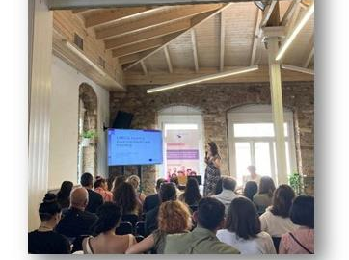
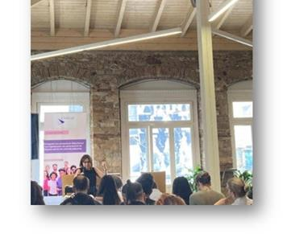
JULY 2023 | NEWSLETTER ISSUE 04
FINAL CONFERENCE ATHENS 1st OF JULY 2023
CRITICAL FINAL CONFERENCE
The Critical Conference was organised as a face-to-face event on 1 st of July in Athens, at Impact House Athens, a meeting venue in the centre of Athens, so as to facilitate access to all relevant stakeholders, interested parties and individuals and get them directly engaged with the project results. The Conference was organized in-person allowing the successful knowledge transfer. The Critical methodology has been demonstrated engaging relevant stakeholders, leading to networking and constructive discussions and feedback by the participants. The event started with a plenary session and then a workshop regarding the testing of the Critical game followed.
The event was organized in a plenary session with all of the participants where the project and its results were presented and afterwards the participants took part in a workshop, where they have had the opportunity to test the Critical game. Best practices and examples from different EU countries to give a broader perspective on solutions to the existing challenges in EU were discussed. Also, the online interacting learning platform as well as the innovative methodology that helps to strengthen basic language skills of refugees and migrants were discussed thoroughly and feedback was given. Finally, the event had the character of networking with several stakeholders
The CRITICAL project has been funded with the support of the European Commission

Slide 3
JULY 2023 | NEWSLETTER ISSUE 04
FINAL CONFERENCE ATHENS 1st OF JULY 2023
.
.
PARTICIPANTS
The participation at the event was ensured through a pre-online registration from a major NGO Koinoniko EKAV (a Greek acronym for "Hellenic Social Welfare Assistance Unit", the National Direct Aid Center of the public health system], which is a major and independent social organization aiming at combating any form of social exclusion in Greece. Kinoniko EKAV acts through mobile teams, providing immediate sanitary, psychological, and social care, on the very spot where people in need are identified and is considered of great importance in terms of impact and sustainability for our project. Additional stakeholders from adult education organisations, refugee integration, employment services and professionals that cooperate with refugee and integration entities participated in the Conference.
CONCLUSIONS AND OBSERVATIONS
The event in general has met its predetermined goals and the expectations of the participants. Overall impressions of the event were really positive. These findings were satisfactory for DIMITRA organization since the event has positive impact on trainers, tutors, coaches that support refugees and immigrants, etc. During the multiplier event, the participants agreed that the developed outputs and the Critical methodology, the materials developed as well as the Critical online interacting learning platform could contribute to the empowerment and social inclusion of refugee and migrant parents and the strengthening of their basic language skills.

Slide 4
JULY 2023 | NEWSLETTER ISSUE 04
THE PROJECT TEAM
THE PROJECT BRINGS TOGETHER 4 PARTNERS FROM 3 EUROPEAN COUNTRIES, FORMING A TRANSNATIONAL COOPERATION PARTNERSHIP.
COORDINATOR:
FOLK UNIVERSITETET
www.folkuniversitetet.se
Maria.ahlen@folkuniversitetet.se
PARTNERS:
DIMITRA Educational Organization - GREECE
www.iekdimitra.gr
anastasopoulou@dimitra.gr
FISPE - FRANCE
www.fispe.fr
helene.ardisson@fispe.fr
PROMEA - Hellenic Society for the Promotion of Research and Development Methodologies - GREECE
www.promea.gr
projects@promea.gr
This project has been funded with support from the European Commission. This publication communication reflects the views only of the author, and the Commission cannot be held responsible for any use which may be made of the information contained therein.

