Slide 1
MARCH 2023 | NEWSLETTER ISSUE 03
Critical
Critical information for immigrants regarding parenting to promote social inclusion
This project has been funded with support from the European Commission. This publication communication reflects the views only of the author, and the Commission cannot be held responsible for any use which may be made of the information contained therein.
AGREEMENT NUMBER
3RD EDITION OF THE “CRITICAL” NEWSLETTER
2020-1-SE01-KA204-077912
Prepared by FISPE – French for social and professional integration in Europe
START DATE
01.10.2020
DURATION
About the project
CRITICAL is a 35 months Erasmus+ Strategic Partnership project which aims at developing training materials to help migrants and refugees understand the different views and perspectives on parenting and health in the host country, and improve their health status. In particular, the project will develop a methodology to facilitate the use of relevant training materials by immigrants and refugees, based on country-specific conditions.
35 Months

Slide 2
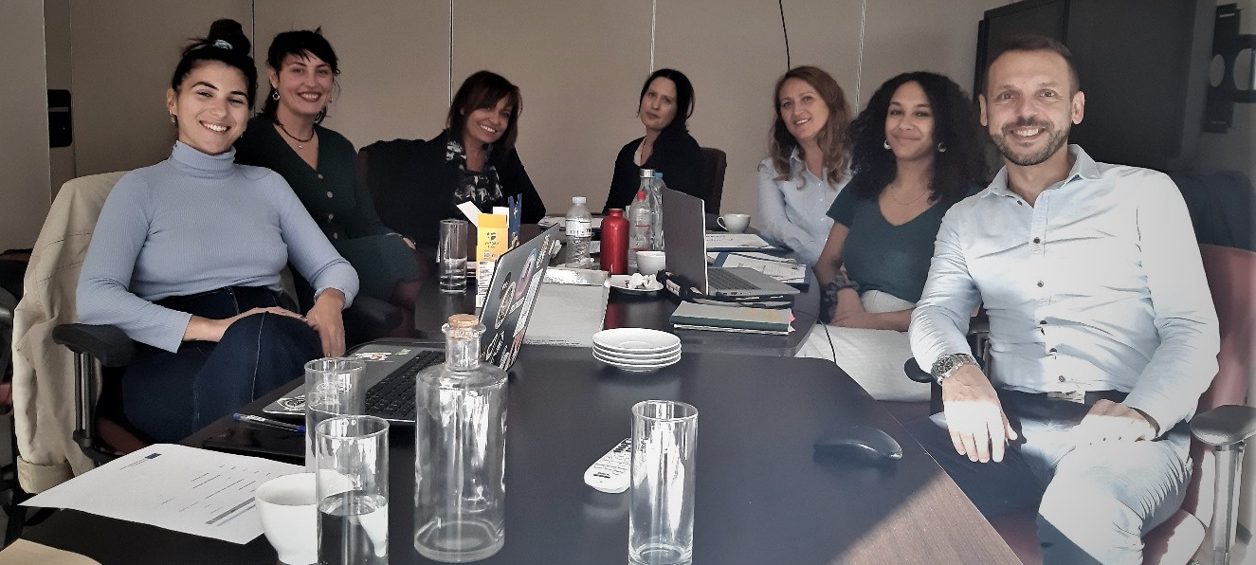
MARCH 2023 | NEWSLETTER ISSUE 03
An update about CRITICAL
Approaching rapidly the end of the project, we are delighted to share with you the 3rd edition of the CRITICAL newsletter.
The year 2022 saw the development of the materials by the partnership. The partners adopted a game-based methodology for this material to promote social inclusion, as the need for a different way to approach the subjects regarding health and parenting was highlighted in the research from the first intellectual output (IO1).
The game-based methodology took the shape of a card game which trainers will rely on to spark conversations on these important and sensitive subjects regarding health and parenting services and norms of the host country. The dynamic of the game is based on the western-popular game “Happy families”, in which the objective is to gather cards (“members”) of a family. In our material, the “families” became subjects such as “I am a single parent”, “My child is sick”, “My insurance card”, etc. Each subject is an occasion for all participants to exchange knowledge, thus fostering interculturality and efficient learning.
The Dutch partner of the consortium, Revalento, provided the partnership with the initial idea as well as rules and training material of the game. Each partner then developed the content of their cards considering their own national context: the game is different for each partner since there are various health and parenting services, and although it is less obvious in the European countries of the partnership, different norms regarding parenting.
Only Folkuniversitetet (Sweden) decided to use a different type of material which they had previously developed for another theme, however still aligned with the needs regarding barriers to the communication of the information to immigrants.
The partnership discussed all technical aspects of the piloting phase (IO3) and of the development of the digital learning platform (IO4), especially regarding what would be the game mechanics online, during the 4th Transnational Partners Meeting of the project in Athens in October 2022. Partners also had the opportunity to talk through all dissemination, management and quality evaluation aspects of the project.
The partners will lastly meet again during the 5th TPM and Final conference in Larissa in May/June 2023.
The CRITICAL project has been funded with the support of the European Commission

Slide 3
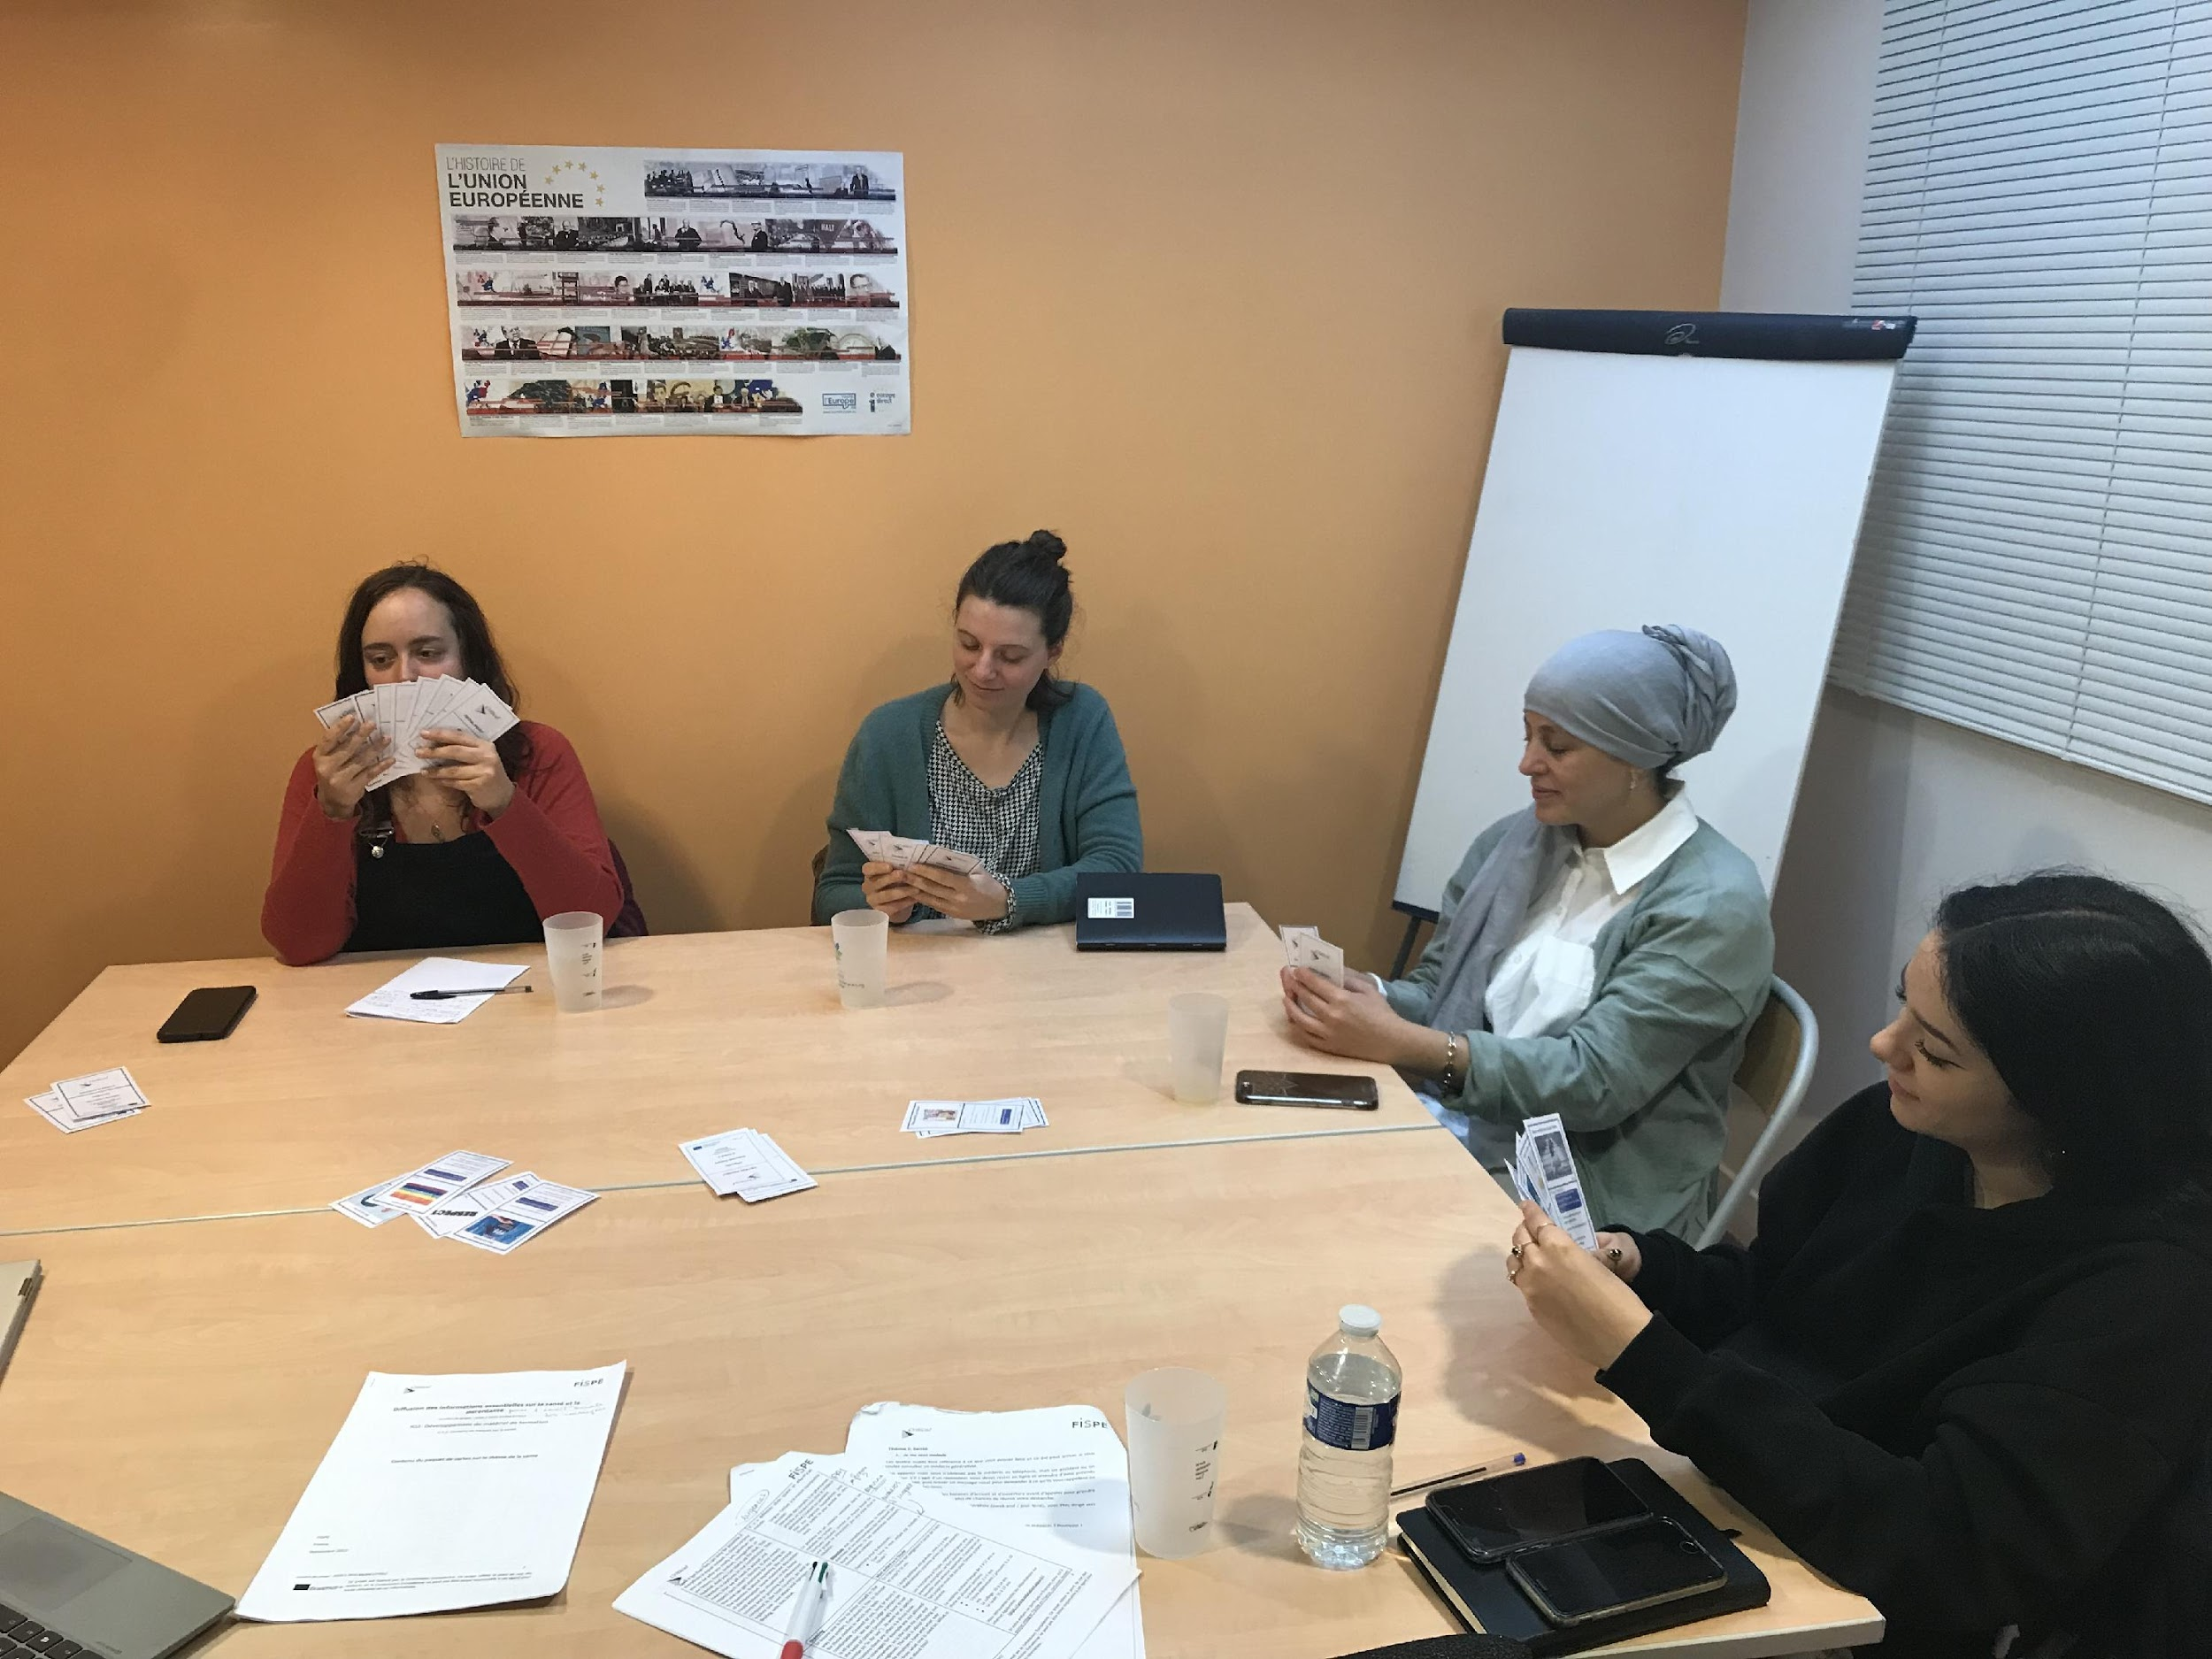
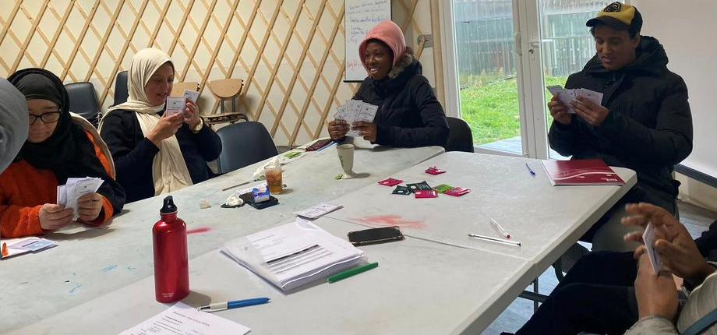
MARCH 2023 | NEWSLETTER ISSUE 03
IMPLEMENTATION OF PILOTING – August 2022-April 2023
The development of the game and training materials was indeed followed by training the trainers sessions, where social workers and foreign language trainers were taught how to use the developed material in their activities. Training sessions were made of an explanation of the game with encouraged participation of the trainees, and of a game session for them to have an example of how the game should be played. These training sessions were also an opportunity for the partnership to gather feedback, on the training itself as well as on the material they were about to test themselves. Every training session offered valuable new ideas and opinions on how to improve our material.
The testing phase of the project material took place between August 2022 and March 2023. Partners are now reporting from the testing sessions, which will put an end to the piloting phase of the project by the end of April 2023. Multiple testing sessions were organized in all the different countries of the partnership such as Greece, Sweden and France.
Meanwhile, the Greek partner Promea has been working since November 2022 on the online learning platform as it was planned to offer better accessibility to the game content.
NEXT STEPS
IO4: Online learning platform implementation, evaluation and finalisation
As the game testing was a success and the methodology approved by social workers, language trainers and immigrants, the project always had the accessibility of the learning material as an objective. In this regard, Promea has been developing an adequate online version with different dynamics but keeping the same pedagogical content in each language. Still to be done are the implementation, evaluation and finalization of the material, as well as the final conference for dissemination of the project results and further impact.

Slide 4
MARCH 2023 | NEWSLETTER ISSUE 03
THE PROJECT TEAM
THE PROJECT BRINGS TOGETHER 4 PARTNERS FROM 3 EUROPEAN COUNTRIES, FORMING A TRANSNATIONAL COOPERATION PARTNERSHIP.
COORDINATOR:
FOLK UNIVERSITETET
www.folkuniversitetet.se
Maria.nyberg1@folkuniversitetet.se
PARTNERS:
DIMITRA Educational Organization - GREECE
www.iekdimitra.gr
anastasopoulou@dimitra.gr
FISPE - FRANCE
www.fispe.fr
helene.ardisson@fispe.fr
PROMEA - Hellenic Society for the Promotion of Research and Development Methodologies - GREECE
www.promea.gr
projects@promea.gr
This project has been funded with support from the European Commission. This publication communication reflects the views only of the author, and the Commission cannot be held responsible for any use which may be made of the information contained therein.

